Slide 1
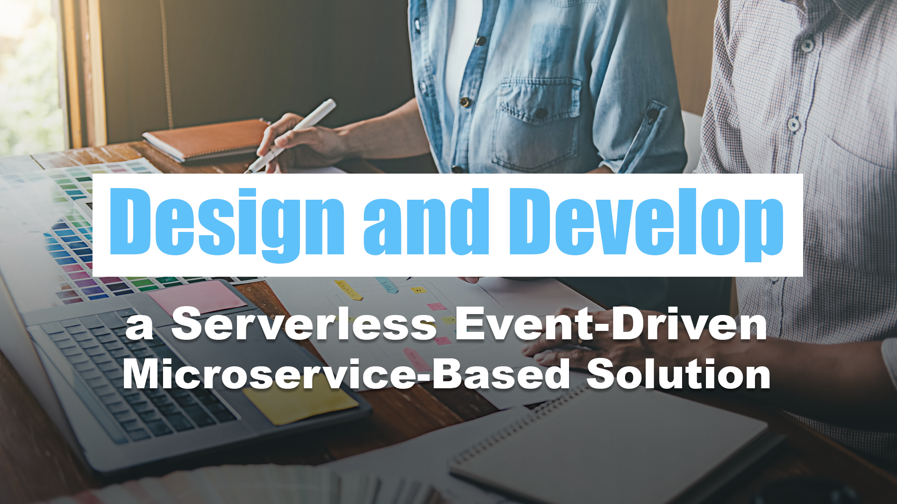
04 – Architecture Concepts

Slide 2
Microservices
Design and Develop a Serverless Event-Driven Microservice-Based Solution

Slide 3
What are microservices?
Monolithic Architecture
Microservices Architecture
User Interface
User Interface
Business Logic
Microservice
Microservice
Microservice
Microservice
Application Database
Microservice
Database
Microservice
Database
Microservice
Database
Microservice
Database
Notes:
Imagine taking an application, chopping it up into pieces, and running it as a collection of smaller parts instead of one monolithic whole. That is basically what a microservices architecture is.
Monolithic Architecture — 3-Tier/N-Tier Architecture
One part of the application breaks, the whole application might fail
Microservices Architecture
From the user’s perspective, an application built with microservices has a single interface and should work just the same as an application designed as one stack. However, behind the scenes each microservice potentially has its own database and runs separately from the rest of the application. In addition, microservices within the same application can be written in different languages and use different libraries.

Slide 4
What are microservices?
Monolithic Architecture
Microservices Architecture
User Interface
User Interface
Business Logic
Microservice
Microservice
Microservice
Microservice
Application Database
Microservice
Database
Microservice
Database
Microservice
Database
Microservice
Database
Application
Database
Notes:
Anit-pattern that might make sense: one database

Slide 5
Advantages of Microservices
Quick
Notes:
Quick
Microservices increase agility putting new feature sin production and adding business value to solutions, as the deployment of small and independent modules requires much less time and several teams can be working on different services at the same time, reducing development time and simplifying deployment.

Slide 6
Advantages of Microservices
Quick
Quick

Slide 7
Advantages of Microservices
Quick
Resilience
Notes:
Resilience
Because the application is divided up, one part of the application breaking or crashing does not (should not) necessarily affect the rest of the application.
Each of the services can be managed independently, isolated potential problem areas to individual services, and replacing or retiring services when deprecated or unused without affecting the overall structure and functionality.

Slide 8
Advantages of Microservices
Quick
Scalability
Resilience
Resilience

Slide 9
Advantages of Microservices
Quick
Resilience
Scalability
Notes:
Scalability
Instead of scaling the entire application, only the microservices that receive a great deal of usage can be scaled.
The independent microservices modules and their related services can be individually and automatically scaled based on their respective demands without impacting the application’s overall performance. The ability to independently scale removes the need to scale the entire app up or down, potentially saving costs and reducing downtime.

Slide 10
Advantages of Microservices
Quick
Resilience
Scalability
Scalability
Maintainability

Slide 11
Advantages of Microservices
Quick
Resilience
Scalability
Maintainability
Maintainability
Flexibility

Slide 12
Advantages of Microservices
Quick
Resilience
Scalability
Flexibility
Maintainability
Notes:
Flexibility
Microservices can be written in different languages and each have their own libraries.
Microservice solutions let development teams use the best deployment approach, language, platform and programming model for each service, providing flexibility in choosing technologies and tools.

Slide 13
Advantages of Microservices
Scalability
Resilience
Scalability
Quick
Resilience
Quick
Flexibility
Flexibility
Maintainability
Maintainability
Notes:
Quick
Microservices increase agility putting new feature sin production and adding business value to solutions, as the deployment of small and independent modules requires much less time and several teams can be working on different services at the same time, reducing development time and simplifying deployment.
Resilience
Because the application is divided up, one part of the application breaking or crashing does not (should not) necessarily affect the rest of the application.
Each of the services can be managed independently, isolated potential problem areas to individual services, and replacing or retiring services when deprecated or unused without affecting the overall structure and functionality.
Scalability
Instead of scaling the entire application, only the microservices that receive a great deal of usage can be scaled.
The independent microservices modules and their related services can be individually and automatically scaled based on their respective demands without impacting the application’s overall performance. The ability to independently scale removes the need to scale the entire app up or down, potentially saving costs and reducing downtime.
Maintainability
Features can be rolled out or updated one at a time, instead of updating the entire stack.
Flexibility
Microservices can be written in different languages and each have their own libraries.
Microservice solutions let development teams use the best deployment approach, language, platform and programming model for each service, providing flexibility in choosing technologies and tools.

Slide 14
Advantages of Microservices
Quick
Resilience
Scalability
Maintainability
Flexibility
Notes:
Quick
Microservices increase agility putting new feature sin production and adding business value to solutions, as the deployment of small and independent modules requires much less time and several teams can be working on different services at the same time, reducing development time and simplifying deployment.
Resilience
Because the application is divided up, one part of the application breaking or crashing does not (should not) necessarily affect the rest of the application.
Each of the services can be managed independently, isolated potential problem areas to individual services, and replacing or retiring services when deprecated or unused without affecting the overall structure and functionality.
Scalability
Instead of scaling the entire application, only the microservices that receive a great deal of usage can be scaled.
The independent microservices modules and their related services can be individually and automatically scaled based on their respective demands without impacting the application’s overall performance. The ability to independently scale removes the need to scale the entire app up or down, potentially saving costs and reducing downtime.
Maintainability
Features can be rolled out or updated one at a time, instead of updating the entire stack.
Flexibility
Microservices can be written in different languages and each have their own libraries.
Microservice solutions let development teams use the best deployment approach, language, platform and programming model for each service, providing flexibility in choosing technologies and tools.

Slide 15
Serverless
Design and Develop a Serverless Event-Driven Microservice-Based Solution

Slide 16
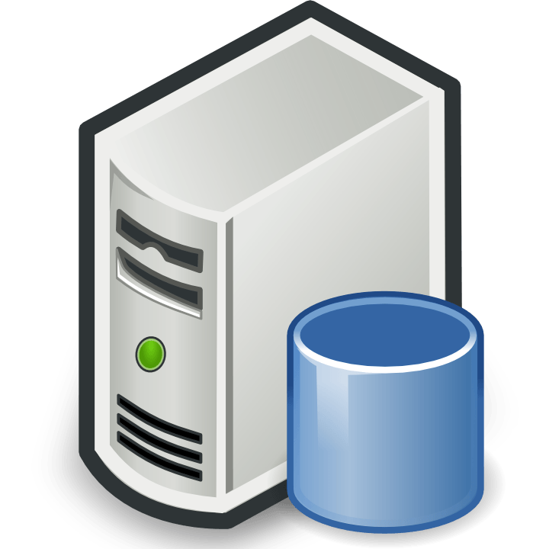





The evolution of application platforms
On-Premises
What happens in case of
server hardware failure?
How can I increase
server utilization?
What media should I
use to keep backups?
What size of servers
should I buy?
How do I deploy new
code to my servers?
Who monitors
my apps?
How often should I
backup my server?
How can I scale my app?
Which packages should
be on my server?
Are my servers in
a secure location?
Do I need a secondary
Network connection?
How do I keep the operating
system up to date?
Who has physical
access my servers?
Who monitors
my servers?
What storage do
I need to use?
How many
servers
do I need?
What happens in case of
server hardware failure?
Do I need a UPS?
How can I dynamically
configure my app?
It takes how long to
provision a new server?
How often should I
patch my severs?
Notes:
Get Hardware
Get and install your operating system
Get and install the application framework
(No Click) Deploy code to the server
Host all of this somewhere in your datacenter and make available to the Internet
(No Click) Bunch of questions
Backup for your apps
Physical Security
Scaling Up
Monitoring (hardware and application)
And so on
(No Click) Really important questions – but not key to core competency

Slide 17
The evolution of application platforms
On-Premises
What happens in case of
server hardware failure?
How can I increase
server utilization?
What media should I
use to keep backups?
What size of servers
should I buy?
How do I deploy new
code to my servers?
Who monitors
my apps?
How often should I
backup my server?
How can I scale my app?
Which packages should
be on my server?
Are my servers in
a secure location?
Do I need a secondary
Network connection?
How do I keep the operating
system up to date?
Who has physical
access my servers?
Who monitors
my servers?
What storage do
I need to use?
How many
servers
do I need?
What happens in case of
server hardware failure?
Do I need a UPS?
How can I dynamically
configure my app?
It takes how long to
provision a new server?
How often should I
patch my severs?
Notes:
Get Hardware
Get and install your operating system
Get and install the application framework
(No Click) Deploy code to the server
Host all of this somewhere in your datacenter and make available to the Internet
(No Click) Bunch of questions
Backup for your apps
Physical Security
Scaling Up
Monitoring (hardware and application)
And so on
(No Click) Really important questions – but not key to core competency

Slide 18
The evolution of application platforms
IaaS
What happens in case of
server hardware failure?
What is the right size of servers for my business needs?
How can I increase
server utilization?
How can I increase server utilization?
What media should I
use to keep backups?
What size of servers
should I buy?
How do I deploy new
code to my servers?
How many servers do I need?
How can I scale my application?
Who monitors
my apps?
How often should I
backup my server?
How can I scale my app?
Which packages should
be on my server?
Are my servers in
a secure location?
Do I need a secondary
Network connection?
How do I keep the operating
system up to date?
Who has physical
access my servers?
How do I deploy new code to my server?
How often should I patch my servers?
Who monitors
my servers?
What storage do
I need to use?
How many
servers
do I need?
How do I keep the operating system up to date?
How often should I backup my server?
Who monitors my application?
Which packages should be on my server?
What happens in case of
server hardware failure?
Do I need a UPS?
How can I dynamically
configure my app?
It takes how long to
provision a new server?
How often should I
patch my severs?

Slide 19

The evolution of application platforms
PaaS
What is the right size of servers for my business needs?
How can I increase server utilization?
How many servers do I need?
How can I scale my application?
How do I deploy new code to my server?
How often should I patch my servers?
How do I keep the operating system up to date?
How often should I backup my server?
Which packages should be on my server?
Who monitors my application?
Notes:
A lot of decisions are easily configurable
(Click) But still have to think about how to scale

Slide 20
The evolution of application platforms
Serverless
What is the right size of servers for my business needs?



How can I increase server utilization?

How many servers do I need?




How can I scale my application?


























Notes:
Only Problem: How to build you application to best solve business problem?

Slide 21
The evolution of application platforms
Serverless


































Notes:
Only Problem: How to build you application to best solve business problem?

Slide 22
Not there isn’t servers
Just, you can think about the servers less
Server Configuration
Server Scaling
Notes:
You focus less on servers and more on the functionality and features of your solution.
Abstraction
This is because serverless abstracts away servers so you do not need to worry about server configuration or scaling

Slide 23
Serverless Benefits
No Server Management

Slide 24
Serverless Benefits
Simplified Scalability
No Server Management
No Server Management

Slide 25
Serverless Benefits
No Server Management
Simplified Scalability

Slide 26
Serverless Benefits
No Server Management
Simplified Scalability
Simplified Scalability
Lower Costs

Slide 27
Serverless Benefits
No Server Management
Simplified Scalability
Lower Costs

Slide 28
Serverless Benefits
No Server Management
Simplified Scalability
Lower Costs
Lower Costs
Quicker Turnaround

Slide 29
Serverless Benefits
No Server Management
Simplified Scalability
Lower Costs
Quicker Turnaround

Slide 30
Serverless Benefits
No Server Management
Simplified Scalability
Lower Costs
Simplified Code
Quicker Turnaround
Quicker Turnaround

Slide 31
Serverless Benefits
No Server Management
Simplified Scalability
Lower Costs
Simplified Code
Quicker TUrnaround

Slide 32
Serverless Benefits
Scalability
Resilience
Lower Costs
Quick
Simplified Scalability
No Server Management
Simplified Code
Simplified Code
Maintainability
Quicker Turnaround

Slide 33
Serverless Benefits
No Server Management
Simplified Scalability
Lower Costs
Quicker Turnaround
Simplified Code

Slide 34
Disadvantages of Serverless
Testing Challenges

Slide 35
Disadvantages of Serverless
Security Concerns
Testing Challenges
Testing Challenges

Slide 36
Disadvantages of Serverless
Testing Challenges
Security Concerns
Notes:
Vendors run the entire backend
Providers often running code from several customers on single server at any given time (multitenancy)

Slide 37
Disadvantages of Severless
Testing Challenges
Short-Running Processes
Security Concerns
Security Concerns

Slide 38
Disadvantages of Serverless
Testing Challenges
Security Concerns
Short –Running Processes

Slide 39
Disadvantages of Serverless
No Server Management
Simplified Scalability
Short-Running Processes
Cold Starts
Short-Running Processes

Slide 40
Disadvantages of Serverless
Testing Challenges
Security Concerns
Short-Running Processes
Cold Starts

Slide 41
Disadvantages of Serverless
Testing Challenges
Security Concerns
Short-Running Processes
Cold Starts
Cold Starts
Vendor
Lock-In

Slide 42
Disadvantages of Serverless
Testing Challenges
Security Concerns
Short-Running Processes
Vendor
Lock-In
Cold Starts

Slide 43
Disadvantages of Serverless
Scalability
Resilience
Short-Running Processes
Quick
Security Concerns
Testing Challenges
Vendor
Lock-In
Vendor
Lock-In
Maintainability
Cold Starts

Slide 44
Disadvantages of Serverless
Testing Challenges
Security Concerns
Short-Running Processes
Cold Starts
Vendor
Lock-In

Slide 45
Event-Driven Architecture
Design and Develop a Serverless Event-Driven Microservice-Based Solution

Slide 46
Event-Driven Architecture
A software architecture pattern promoting the production, detection, consumption of, and reaction to events.
- Wikipedia -

Slide 47
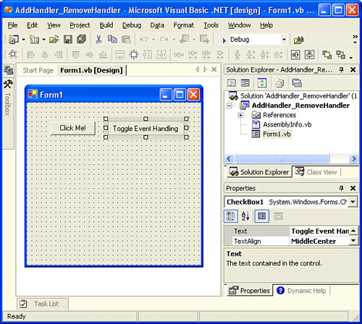
Event-Driven Architecture

Slide 48
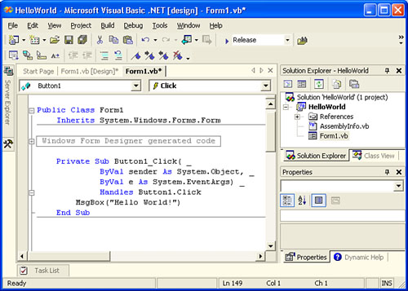
Event-Driven Architecture

Slide 49
Event-Driven Architecture
Event-driven architecture (EDA) is a design paradigm in which a software component executes in response to receiving one or more event notifications.
EDA is more loosely coupled than client/server paradigm because the component that sends the notification doesn’t know the identity of the receiving components at the time of compiling
- Garner -

Slide 50
Event-Driven Architecture
Event-driven architecture (EDA) is a design paradigm in which a software component executes in response to receiving one or more event notifications.
EDA is more loosely coupled than client/server paradigm because the component that sends the notification doesn’t know the identity of the receiving components at the time of compiling
- Garner -

Slide 51
Event-Driven Architecture
Event Consumer
Event Producer
Event Ingestion
Event Consumer
Event Consumer

Slide 52
Process Flow
UI
API Gateway
Order Processing
Payment Processing
Inventory Management
Notification
Place Order
Place Order
Charge Credit Card
Return Conf #
Update Inventory
Return Confirmation
Send Order Confirmation
Return Confirmation
Create
Shipping Label
Return Confirmation
Return Confirmation
Return Confirmation

Slide 53
Process Flow
Event Ingester
UI
Notify Subscribers
Place Order
Inventory Management
Update Inventory
API Gateway
Place Order
Notifications
Publish Payment Event
Order Processing
Send Order Confirmation
Charge Credit Card
Fulfilment
Payment Processing
Create Shipping Label

Slide 54
Event Consumption Models
Event Streaming
Event Consumer
Pub/Sub
Event Producer
Event Ingestion
Event Consumer
Event Consumer

Slide 55
Consumer Processing Variations
Simple Event Processing
Event Consumer
Event Producer
Event Ingestion
Complex Event Processing
Event Consumer
Event Consumer
Event Stream Processing

Slide 56
External Event Sources
Event Consumer
Event Producer
Event Ingestion
Event Consumer
Event Consumer

Slide 57
Multiple Consumer Instances
Event Consumer
Event Consumer
Event Consumer
Event Consumer
Event Producer
Event Ingestion
Event Consumer
Event Consumer
Event Consumer
Event Consumer
Event Consumer
Event Consumer
Event Consumer
Event Consumer

Slide 58
When to use this architecture
Multiple Subsystems
Real-Time Processing
Complex Event Processing
High Volume/Velocity Data

Slide 59
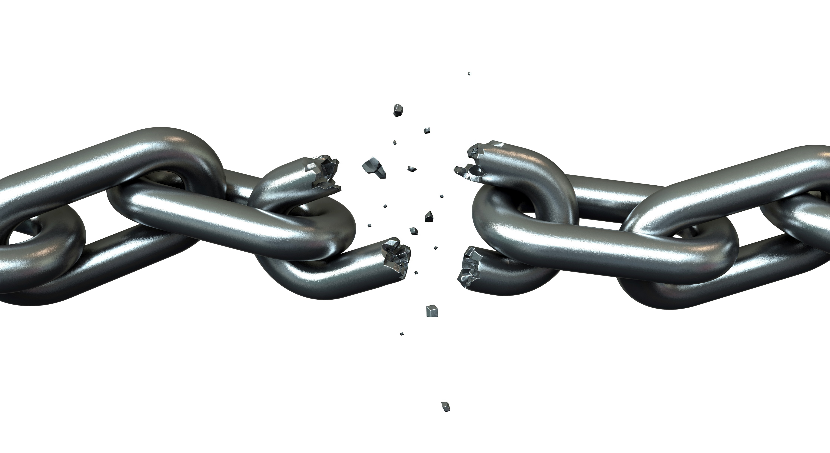


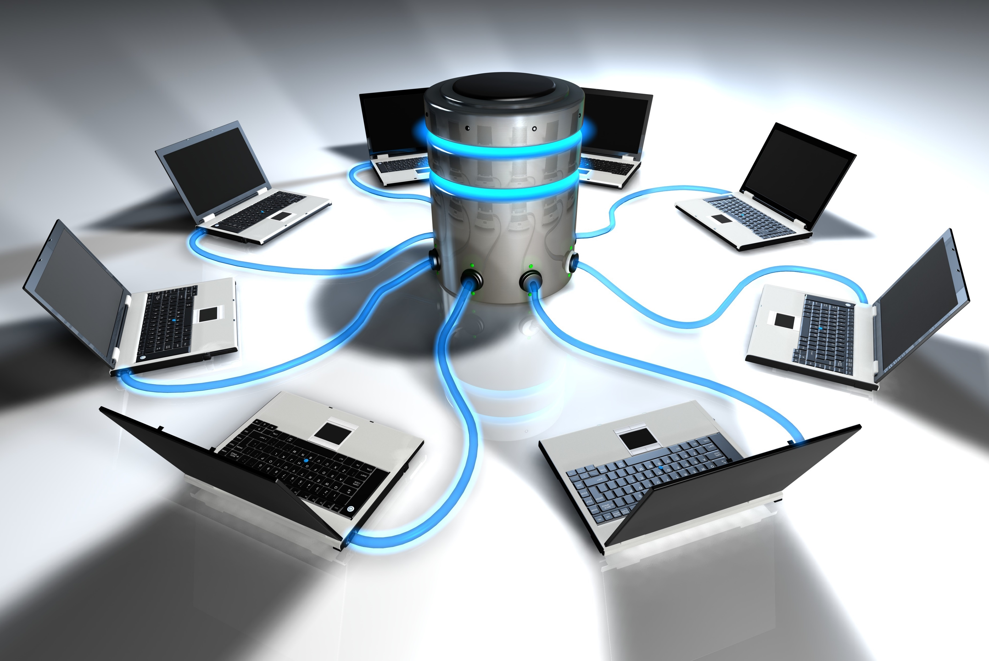

Benefits
Decoupling
Encapsulation
Responsive
Scalable/Distributed
Independence

Slide 60




Drawbacks
Steep Learning Curve
Complexity
Loss of Transactionality
Lineage

Slide 61


Limitations
Guaranteed Delivery
Sequencing

